Slide 1
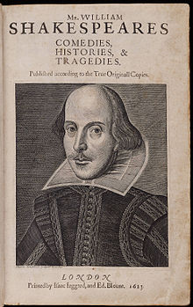
Introduction to William Shakespeare

Slide 2
Shakespeare, the Writer
Collection of writing:
37 plays, 154 sonnets, and 2 long poems
Works not published during his lifetime:
Published four years after his death in the "First Folio" book
Shakespeare is considered a "man for all
seasons" because his plays appeal to everyone across time and ages.
Many of Shakespeare’s manuscripts were lost due
to the burning of theaters by the Puritans.

Slide 3
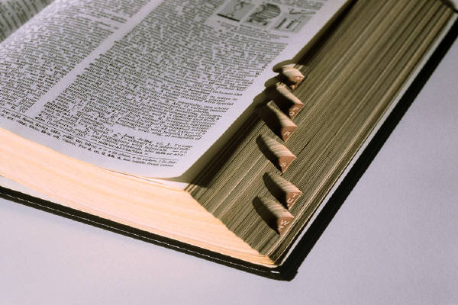
Shakespeare and our Language
According to the Oxford English Dictionary, all the bold-faced words below (and some 500 more) are attributed to Shakespeare:
“[f]rom the spectacled pedant to the schoolboy, all gentlefolk recognize Shakespeare as a fathomless fount of coinages. The honey-tongued Bard had no rival, nor could he sate his never-ending addiction to madcap, flowery (or foul-mouthed!) neologisms. Even time-honored exposure cannot besmirch our amazement at the countless and useful words that lend radiance to our lackluster lives. All in a day’s work!”

Slide 4
Shakespeare and our Language: INSULTS
Example: Thou rank rump-fed hedge-pig!
Column A Column B Column C
peevish clay-brained canker blossom
grizzled dog-hearted clot pole
greasy evil-eyed hedge-pig
jaded lily-livered dogfish
waggish mad-bred egg-shell
purpled onion-eyed younker
rank paper-faced pantaloon
saucy rump-fed rabbit-sucker
vacant shag-eared snipe
yeasty whit-livered

Slide 5
Shakespeare and our Language: compliments
Example: Thou precious young-eyed wafer-cake!
Column A Column B Column C
rare honey-tongued smilet
sweet well-wishing toast
fruitful fair-faced cukoo-bud
brave best-tempered nose-herb
sugared tender-hearted wafer-cake
flowering tiger-booted pigeon-egg
precious smooth-faced welsh cheese
gallant thunder-darting song
celestial sweet-suggesting true-penny
delicate young-eyed valentine

Slide 6
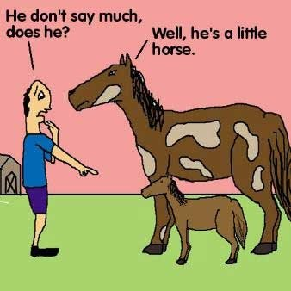
Shakespeare and our Language: Puns

Slide 7
Shakespeare and our Language: Puns
“The humorous use of a word(s) which are formed or sound alike but have different meanings, in such a way as to play on two or more of the possible applications; a play on words.” (Webster Dictionary)
Example:
1)A chicken crossing the road is poultry in motion.
2) Police were called to a daycare where a three-year-old was resisting a rest.

Slide 8
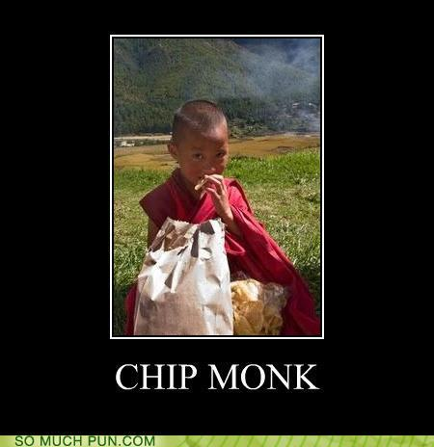
Shakespeare and our Language: Puns
That’s very punny!
Quick setup (Brevity is important.)
No proper names.
Familiar references.
A pointed revelation (You should see the spark in the listener’s eyes as they “get it.”)
Maximum wordplay throughout!

Slide 9
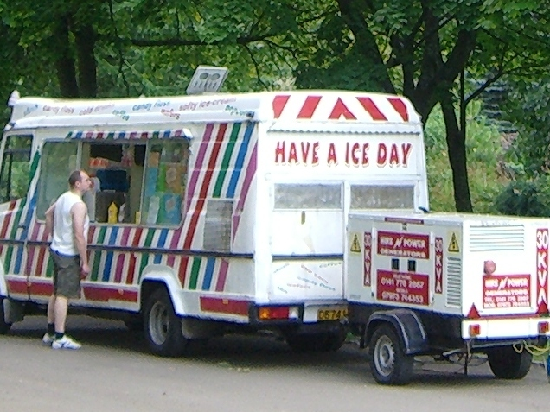
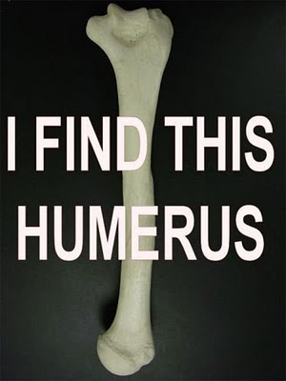
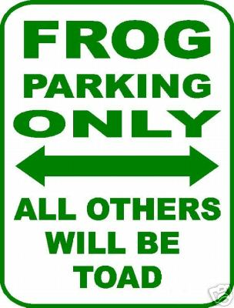
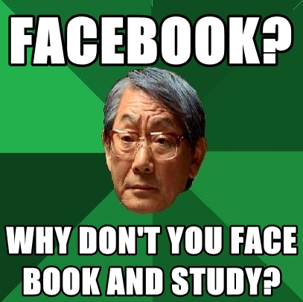
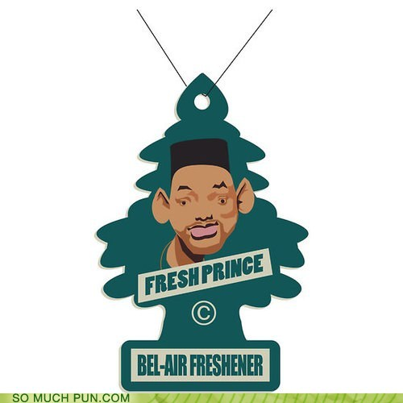

Slide 10
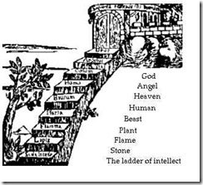
Shakespeare and the great chain of being
Medieval metaphor illustrating hierarchy of being from God to the lowliest non-being
Chain stretched from the foot of God’s throne to the tiniest particle of sand: a place for everything, and everything in its place

Slide 11
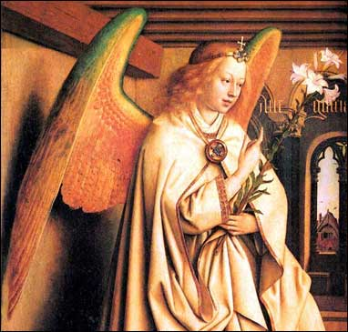
the great chain of being: Angels
Just below God
Had reason and spirit but no body
With no body - immortal
Could fall by free will

Slide 12
the great chain of being: Man
Just below the angels
Could aspire to greater perfection (angelic or god-like)
Had reason in common with angels
Had body (mortality), unlike angels; had feeling, understanding
Incorporated features of lower classes—thus a “microcosm”
Could fall to the level of beast (free will)

Slide 13
the great chain of being: Man

Slide 14
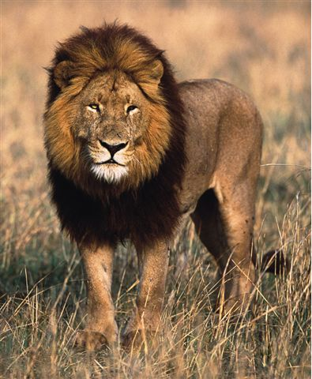
the great chain of being: Higher Sensitive Class
Below human (no reason; no soul)
Hierarchy within each subset:
Highest mammal?
Highest fish?
Highest bird?

Slide 15
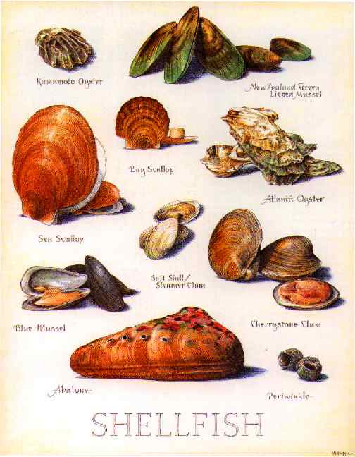
the great chain of being: Lower Sensitive Class
Creatures have life and touch but no feeling or memory (parasites or shellfish, for example)
Creatures having movement but not hearing (such as ants)

Slide 16
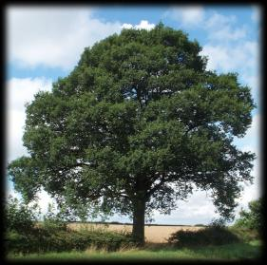
the great chain of being: Vegetative Class
Existence and life, but no feeling, understanding, or movement

Slide 17
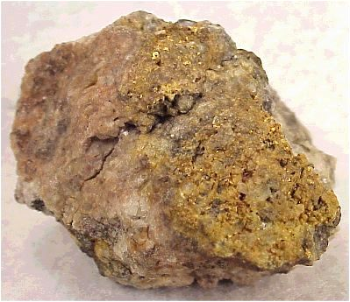
the great chain of being: Inanimate
Elements, liquids, and metals
No sensation, but durable for centuries
Water higher than earth
Four elements: earth, air, fire, water

Slide 18
the great chain of being: Order and Chaos
As long as every
member of every
class followed its
specialty, stayed
within its realm,
order reigned in a
sort of “cosmic dance.”

Slide 19
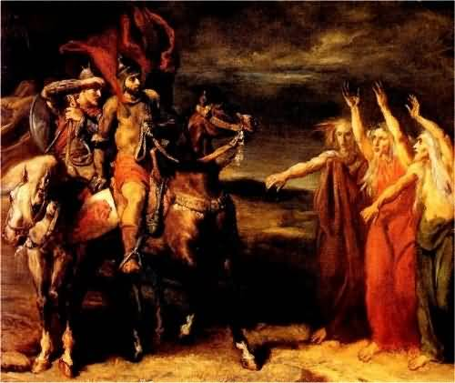
the great chain of being: Disruption
“Sin” or crime causes a disturbance in the “chain of being”
A disturbance shakes the chain and disrupts every other class, especially if the human was high in his class (king or prince).

Slide 20
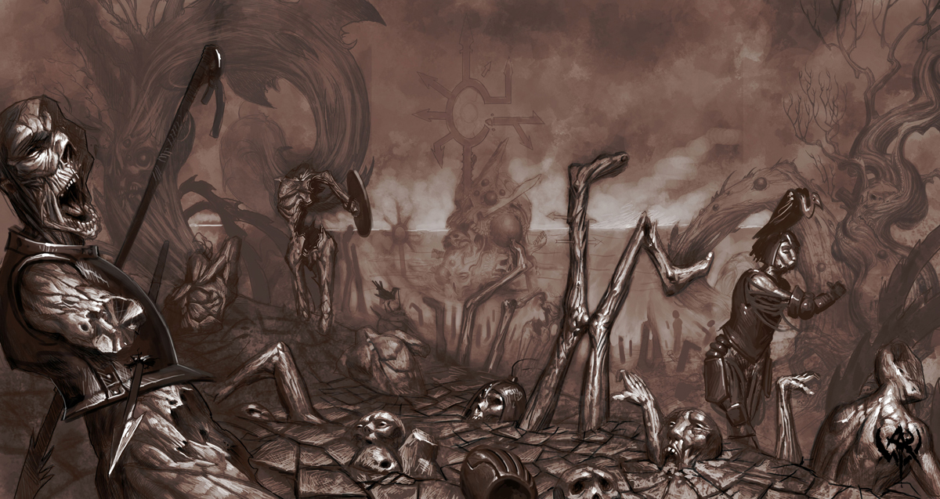
the great chain of being: In the Meantime
Chaos-disorder was reflected in all other realms (eclipse of the sun; animals behaving unnaturally).
Order must be restored.

